Slide 1
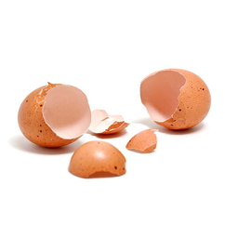
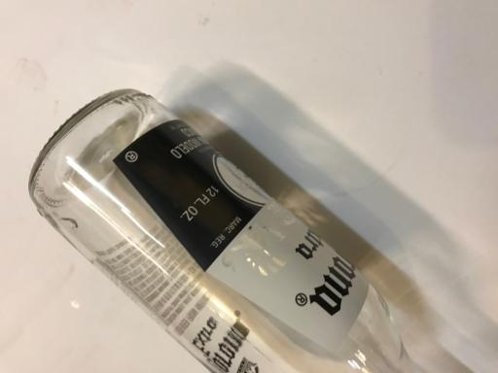
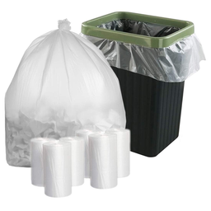
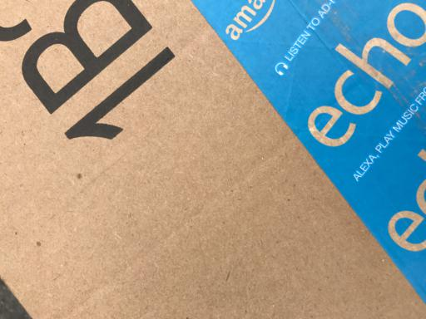
Smart Industrial Waste Sorting Systems

Slide 2
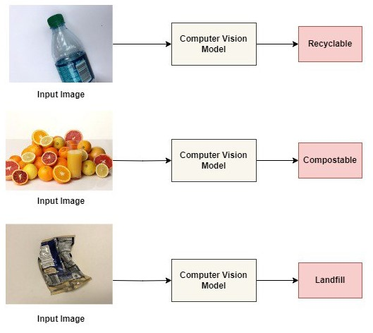
Introduction & Objective
Introduction:
Global Challenge: Increasing waste contributes to environmental degradation and health risks.
Need for Efficiency: Manual sorting is inefficient and error-prone.
Technological Solution: Using CNNs for accurate, automated waste classification.
Figure 1: Simulation of different categories of waste materials.
Objectives:
Develop Intelligent System: Classify waste into recyclable, compostable, and landfill categories.
Utilize CNN Models: Compare ResNet50, MobileNet V3 Large, EfficientNet B0, and MobileNet V2.
Enhance Sustainability: Improve recycling rates and reduce environmental impact.

Slide 3
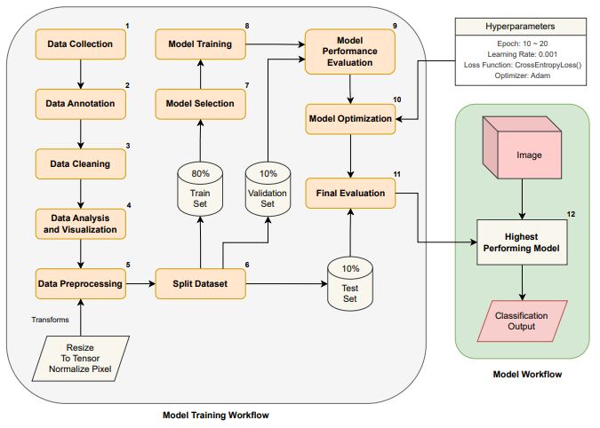
System Design
System Components:
Hardware: Sensors, cameras, and microcontrollers required for deployment in real life.
Software: CNN models implemented in PyTorch for image classification.
Figure 2: Specifications of Software Block Diagram using ML
CNN Models Overview:
ResNet50: Deep architecture for high accuracy.
MobileNet V3 Large: Efficient for mobile and embedded devices.
EfficientNet B0: Balances performance and computational efficiency.
MobileNet V2: Lightweight, suitable for resource-constrained environments.

Slide 4
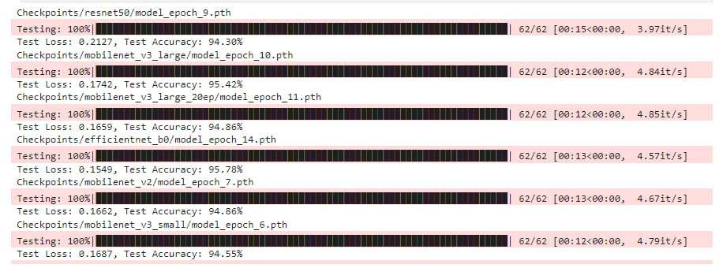
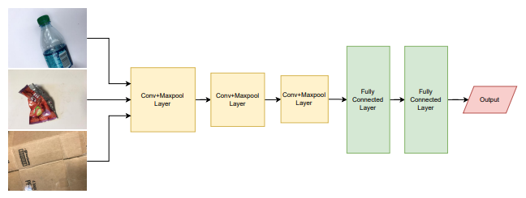
Implementation & Results
Data Collection:
Dataset: High-quality images of waste items categorized into recyclable, compostable, and landfill.
Model Training:
Process: Training CNNs with labeled datasets to optimize classification accuracy.
Performance Metrics:
Accuracy: Comparing the classification accuracy of each model.
Efficiency: Evaluating speed and resource usage.
Figure 3: Model Implementation & Result

Slide 5
Conclusion & Future Work
Conclusion:
Successful Classification: The system accurately classifies waste into the correct categories.
Model Efficiency: CNN models like ResNet50 and MobileNet V3 Large perform well in accuracy and efficiency.
Future Work:
Model Improvement: Explore other models and techniques to enhance accuracy further.
Scalability: Implement the system in real-world waste management facilities.
Sustainability Impact: Monitor long-term effects on recycling rates and environmental impact.

